Slide 1


Diogo Gomes
2022-11

Slide 2

Outline
Executive Summary
Introduction
Methodology
Results
Conclusion
Appendix

Slide 3
Executive Summary
Summary of methodologies
Data Collection (API and web scraping)
Data Wrangling
EDA - Exploratory Data Analysi, wituh further Data Visualization
Interactive Visual Analytics - Folium
Machine Learning Predictions
Summary of all results
Exploratory Data Analysis result
Interactive analytics in screenshots
Predictive Analytics result

Slide 4
Introduction
Project background and context
The object is to evaluate how viable would be for company SpaceY to compete with Space X
Problems you want to find answers
Can we predict if a rocket wil land successfully?
Identify the features that determine the success rate or rocket landing

Slide 5

Section 1

Slide 6
Methodology
Executive Summary
Data collection methodology:
Dataset was collected using SpaceX API and web scraping
Perform data wrangling
Categorical features were processed to be represented as one-hot-encoding
Perform exploratory data analysis (EDA) using visualization and SQL
Perform interactive visual analytics using Folium and Plotly Dash
Perform predictive analysis using classification models
How to build, tune, evaluate classification models

Slide 7
Data Collection
Dataets collected from spaceX api: https://api.spacexdata.com/v4/rockets/
Web scraping from wikipedia

Slide 8

Data Collection – SpaceX API
SpaceX offers a public api
Source code: https://github.com/diogosmg/coursera-DSCapstone/blob/master/Data%20Collection%20API.ipynb

Slide 9

Data Collection - Scraping
Web scraping from Wikipedia using Beautiful soup
https://github.com/diogosmg/coursera-DSCapstone/blob/master/Data%20Collection%20API.ipynb

Slide 10
Data Wrangling
EDA performed to determine the training labels.
https://github.com/diogosmg/coursera-DSCapstone/blob/master/EDA%20-%20Data%20wrangling.ipynb

Slide 11
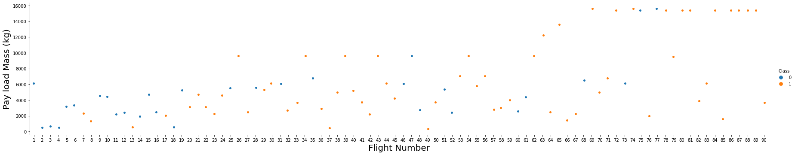
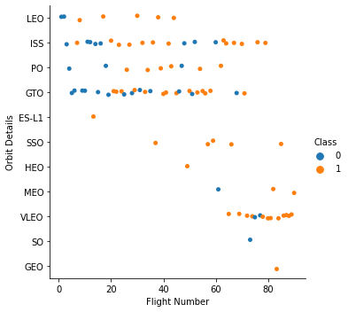
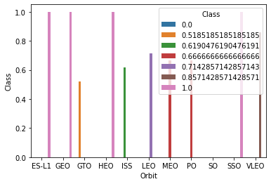
EDA with Data Visualization
Scatterplots and barplots
https://github.com/diogosmg/coursera-DSCapstone/blob/master/EDA%20with%20Data%20Visualization.ipynb

Slide 12
EDA with SQL
SQL Queries:
The names of unique launch sites in the space mission.
The total payload mass carried by boosters launched by NASA (CRS)
The average payload mass carried by booster version F9 v1.1
The total number of successful and failure mission outcomes
The failed landing outcomes in drone ship, their booster version and launch site names.
https://github.com/diogosmg/coursera-DSCapstone/blob/master/EDA%20with%20SQL.ipynb

Slide 13
Build an Interactive Map with Folium
Launch sites were added to the map as markers, circles and lines
https://github.com/diogosmg/coursera-DSCapstone/blob/master/Interactive%20Visual%20Analytics%20with%20Folium%20lab.ipynb

Slide 14
Build a Dashboard with Plotly Dash
Percentage of launches by site and payload range
https://github.com/diogosmg/coursera-DSCapstone/blob/master/Interactive%20Visual%20Analytics%20with%20Folium%20lab.ipynb

Slide 15
Predictive Analysis (Classification)
Dataset was loaded as pandas dataframe, and split into training and testing dataset
We developed different ML models to identify the best performing algorithm
https://github.com/diogosmg/coursera-DSCapstone/blob/master/MLPrediction.ipynb

Slide 16
Results
Exploratory data analysis results
Interactive analytics demo in screenshots
Predictive analysis results

Slide 17

Section 2

Slide 18

Flight Number vs. Launch Site

Slide 19

Payload vs. Launch Site

Slide 20
Success Rate vs. Orbit Type

Slide 21
Flight Number vs. Orbit Type

Slide 22
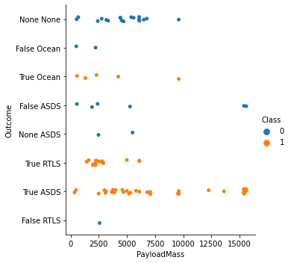
Payload vs. Orbit Type

Slide 23
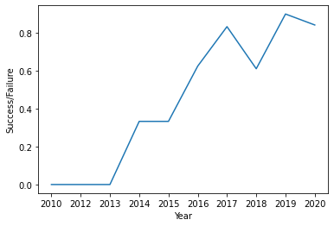
Launch Success Yearly Trend

Slide 24

All Launch Site Names

Slide 25

Launch Site Names Begin with 'CCA'

Slide 26

Total Payload Mass

Slide 27

Average Payload Mass by F9 v1.1

Slide 28
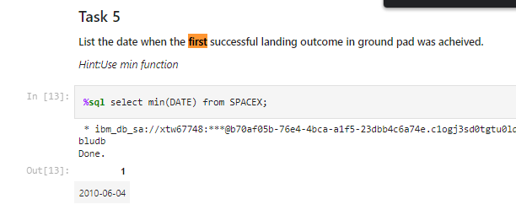
First Successful Ground Landing Date

Slide 29
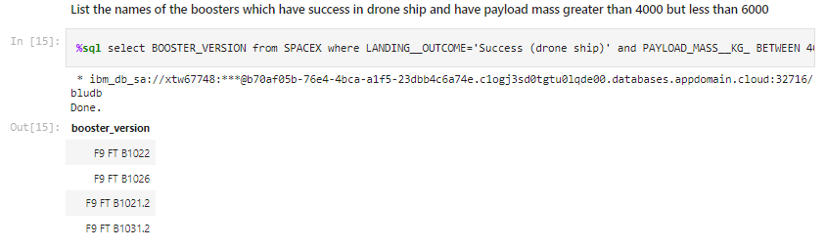
Successful Drone Ship Landing with Payload between 4000 and 6000

Slide 30
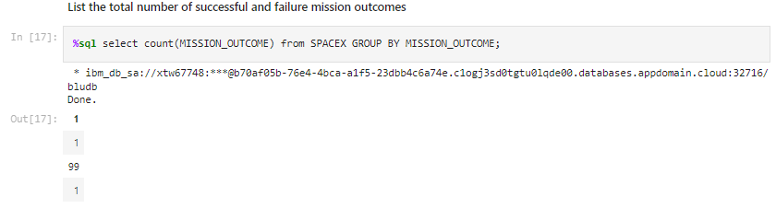
Total Number of Successful and Failure Mission Outcomes

Slide 31
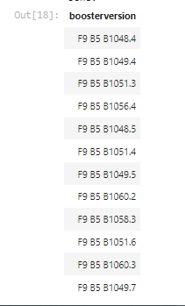
Boosters Carried Maximum Payload

Slide 32
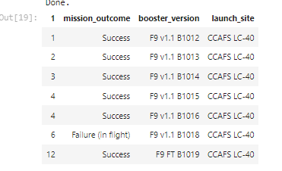
2015 Launch Records

Slide 33
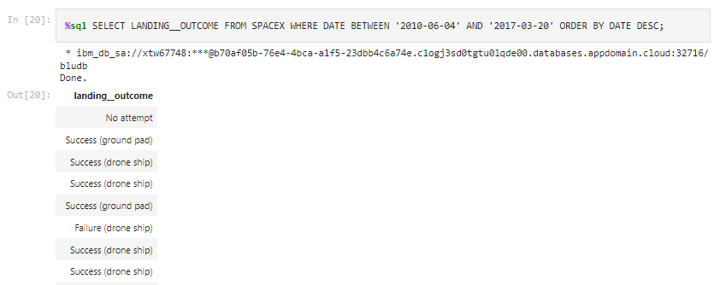
Rank Landing Outcomes Between 2010-06-04 and 2017-03-20

Slide 34

Section 3

Slide 35
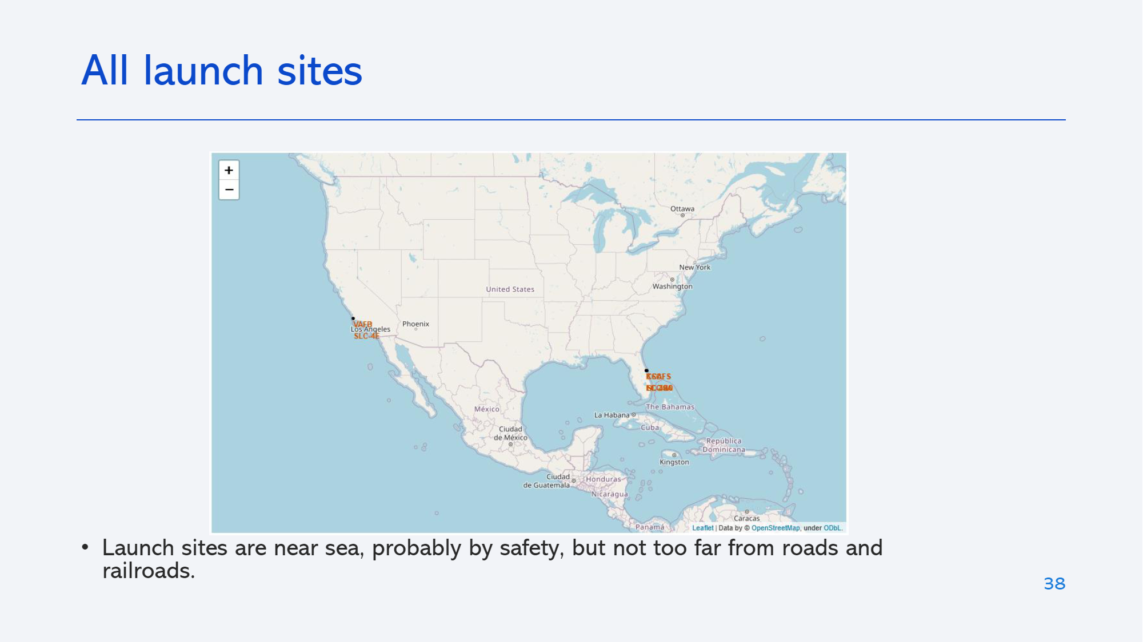
<Folium Map Screenshot 1>

Slide 36
<Folium Map Screenshot 2>

Slide 37

Section 4

Slide 38
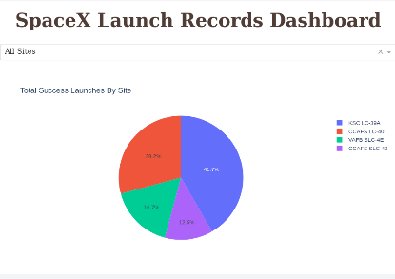
Dashboard

Slide 39
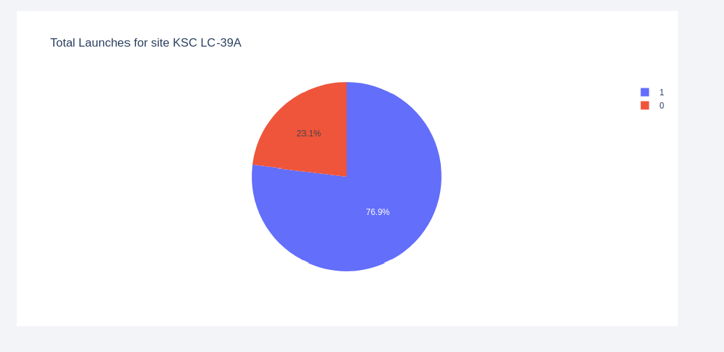
<Dashboard Screenshot 2>

Slide 40

Section 5

Slide 41

Classification Accuracy

Slide 42

Confusion Matrix

Slide 43
Conclusions
Launches above 7ton are less risky
Launch success rate increased from 2013 on.
Decision Tree classified is the algorithm that performed the best for this task

Slide 44
Appendix

Slide 45


